Slide 1
Chapter 5
Understanding Requirements

Slide 2
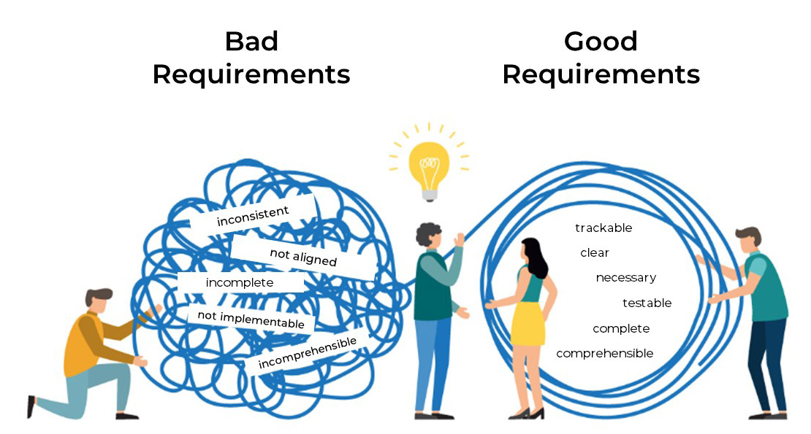
Requirements Engineering
The broad spectrum of tasks and techniques that lead to an understanding of requirements is called requirements engineering.
It beings with communication activity and continues into the modeling activity.
It builds a bridge to design and construction.

Slide 3
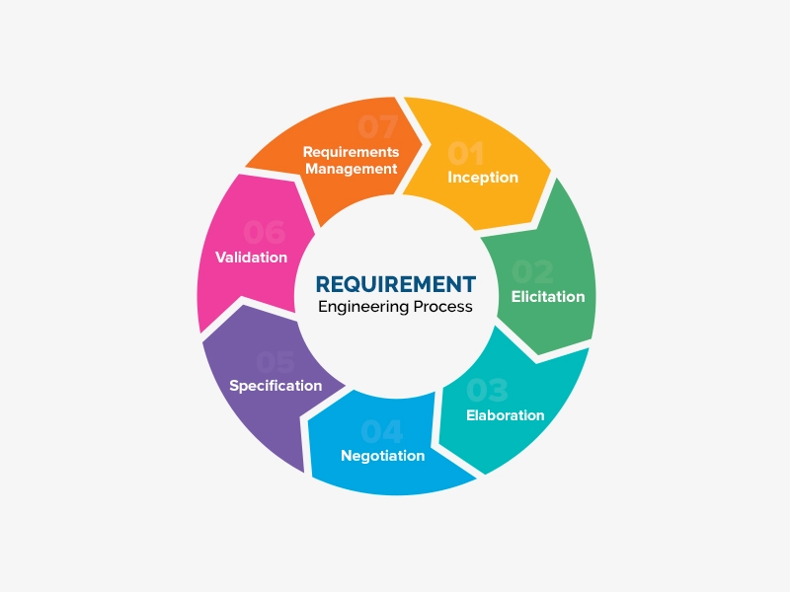


Slide 4
Requirements Engineering-I
Inception—ask a set of questions that establish …
  basic understanding of the problem
  the people who want a solution
  the nature of the solution that is desired, and
  the effectiveness of preliminary communication and collaboration between the customer and the developer
  Groundwork
    Identify stakeholders
    Recognize multiple points of view
    Work toward collaboration

Slide 5
Inception Questions
Question Set 1 – Break the ice
    Who is behind the request for this work?
    Who will use the solution?
    What will be the economic benefit of a successful solution
    Is there another source for the solution that you need?
Question Set 2 : To gain a better understanding of the problem and allow customers to voice their perceptions about solutions
    characterize “good” output
    Problems to this
    business environment in which solution will be used
    Special performance issues or constraints
Final set of questions focuses on the effectiveness of the communication activity itself.
    Are you the right person to answer these questions? Are your answers official?
    Are my questions relevant to the problem that you have?
    Am I asking too many questions?
    Can anyone else provide additional information?
    Should I be asking you anything else?

Slide 6

Requirements Engineering
Elicitation—Gathering Requirements
ask customers, users
  what the objectives,
  what is to be accomplished,
  how the system fits into the needs of the business and
  how the system is to be used on a day-today basis.
meetings are conducted and attended by both software engineers and customers
rules for preparation and participation are established
an agenda is suggested (formal enough and be flexible)
a "facilitator" controls the meeting
a "definition mechanism" (can be work sheets, flip charts, or wall stickers or an electronic bulletin board, chat room or virtual forum) is used
the goal is
  to identify the problem
  propose elements of the solution
  negotiate different approaches, and
  specify a preliminary set of solution requirements

Slide 7
Requirements Engineering
Elaboration
  create an analysis model that identifies, expand and refine data, function and behavioral requirements.
  Driven by user scenarios that describe how the end users and other actors will interact with the system.
Negotiation
  agree on a deliverable system that is realistic for developers and customers
Specification—can be any one (or more) of the following:
  A written document
  A set of graphical models
  A formal mathematical model
  A collection of user scenarios (use-cases)
  A prototype

Slide 8
Requirements Engineering
Validation—a review mechanism that looks for review team to find errors in content or interpretation
  errors in content or interpretation
  areas where clarification may be required
  missing information
  inconsistencies (a major problem when large products or systems are engineered)
  conflicting or unrealistic (unachievable) requirements.
Requirements management
  Requirements change and the desire to change persists throughout the life of the system.
  Help the project team identify, control and track requirements and changes to requirements at any time as the project proceeds.

Slide 9
Product Request for Safe Home Project
One or two-page ”product request” were written out of the initial meetings.
The product requests will be distributed to all attendees.
The home security function would protect against and/or recognize a variety of undesirable situations such as illegal entry, fire, flooding, carbon monoxide levels and others.
It will use our wireless sensors to detect each situation.
It can be programmed by the homeowner, and will automatically telephone a monitoring agency when a situation is detected.

Slide 10
Provide Lists Requirements
Before the meeting make a list of objects that are part of the environment that surrounds the systems, other objects that are to be produced by the system and objects that are used by the system to perform its function.
List of services (processes or functions) that manipulate or interact with the objects.
Finally list of constraints ( e.g. cost, size, business rules) and performance criteria ( e.g., speed, accuracy) are also developed.

Slide 11
Lists Example for SafeHome
Objects : the control panel, smoke detectors, window and door sensors, motion detectors, an alarm, an event ( a sensor has been activated), a display, a PC, telephone numbers, a a telephone call, and so on.
List of services might include configuring the system, setting the alarm, monitoring the sensors, dialing the phone, programming the control panel, and reading the display )( note that service acts on an object).
List of constraints (e.g. the system must recognize when sensor are not operating, must be user-friendly, must interface directly to a standard phone line) and
Performance criteria ( e.g. a sensor event should be recognized within one second, and an event priority scheme should be implemented).

Slide 12
Quality Function Deployment(QFD)
Translates the needs of the customer into technical requirements for software.
It concentrates on maximizing customer satisfaction from the software engineering process. It identifies three types of requirements.
  Normal requirements: objectives and goals stated during meeting with customers.
  Expected requirements: are implicitly and not stated by the customers. Their absence will be a cause for significant dissatisfaction.
  Exciting requirements: Features go beyond the customer’s expectations and prove to be very satisfying when present.
Function deployment determines the “value” (as perceived by the customer) of each function required of the system and deploys these values throughout.

Slide 13
Elicitation Work Product
Will vary depending on the size of the system or product to be built. For most systems, the work products include:
  A statement of need and feasibility
  A bounded statement of scope for the system or product
  A list of customers, users and other stakeholders who participated in requirements elicitation
  A description of the system’s technical environment
  A list of requirements preferably organized by function and the domain constraints that apply to each
  A set of usage scenarios that provide insight into the use of the system or product under different operating conditions.
  Any prototypes developed to better define requirements.

Slide 14
Developing Use Cases
Developers and users can create a set of scenarios that identify a thread of usage for the system to be constructed called use cases.
A use case tells a stylized story about how an end user interacts with the system under a specific set of circumstances.
The story can be a narrative text, an outline of tasks or interactions, a template-based description, or a diagrammatic representation.

Slide 15
Use-Cases
Each scenario answers the following questions:
  Who is the primary actor, the secondary actor (s) ( to support the primary actors)?
  What are the actor’s goals?
  What preconditions should exist before the story begins?
  What main tasks or functions are performed by the actor?
  What extensions might be considered as the story is described?
  What variations in the actor’s interaction are possible?
  What system information will the actor acquire, produce, or change?
  Will the actor have to inform the system about changes in the external environment?
  What information does the actor desire from the system?
  Does the actor wish to be informed about unexpected changes?

Slide 16
Building The Requirement Models
The intent of the analysis/requirement model
  to provide a description of the required informational, functional, and behavioral domains for a computer-based system.
  The model changes dynamically as you learn more about the system to build.
  Other stakeholders understand more about what they rally require.
Different modes of representation
  consider requirements from different viewpoints
  an approach that has a higher probability of uncovering omissions, inconsistencies, and ambiguity.

Slide 17
Building The Requirement Models
A set of generic Elements of the analysis model that are common to all models.
  Scenario-based elements
    Functional—processing narratives for software functions
    Use-case—descriptions of the interaction between an “actor” and the system
  Class-based elements
    Each usage scenario implies a set of objects (actors) that are categorized into classes. State diagram
  Behavioral elements
    State diagram is one method by depicting its states and the events that cause the system to change state.
  Flow-oriented element
    Data flow diagram, input, transform it and produce output.

Slide 18
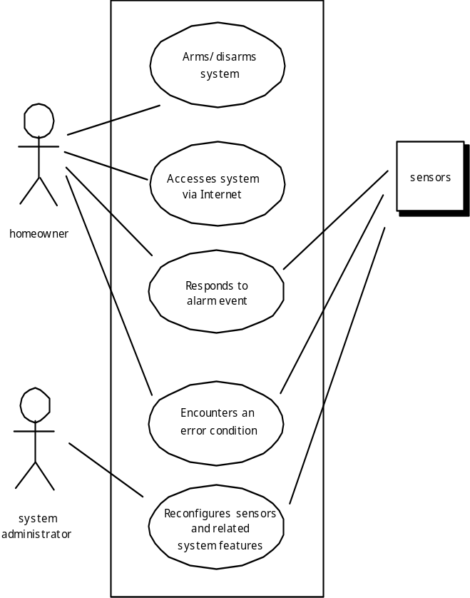
UML Use Case Diagram

Slide 19
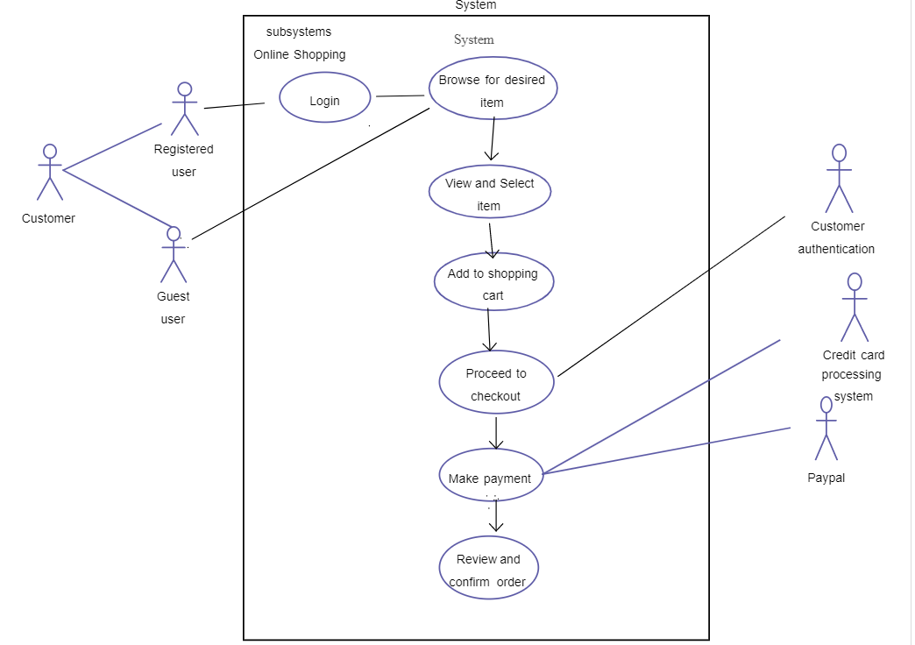
Sample Use Case Diagram

Slide 20
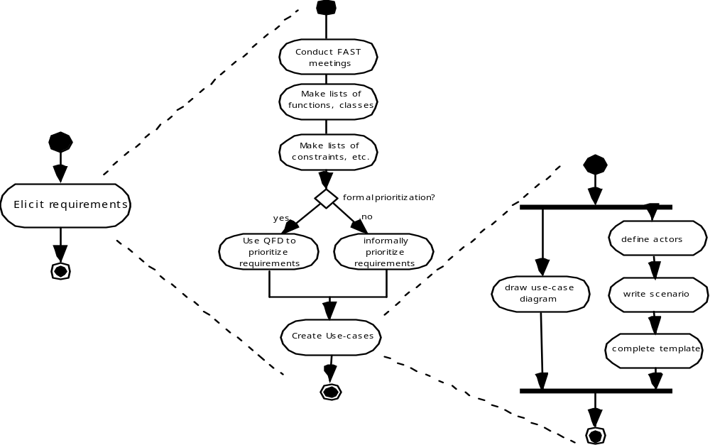
UML Activity Diagrams Eliciting Requirements

Slide 21
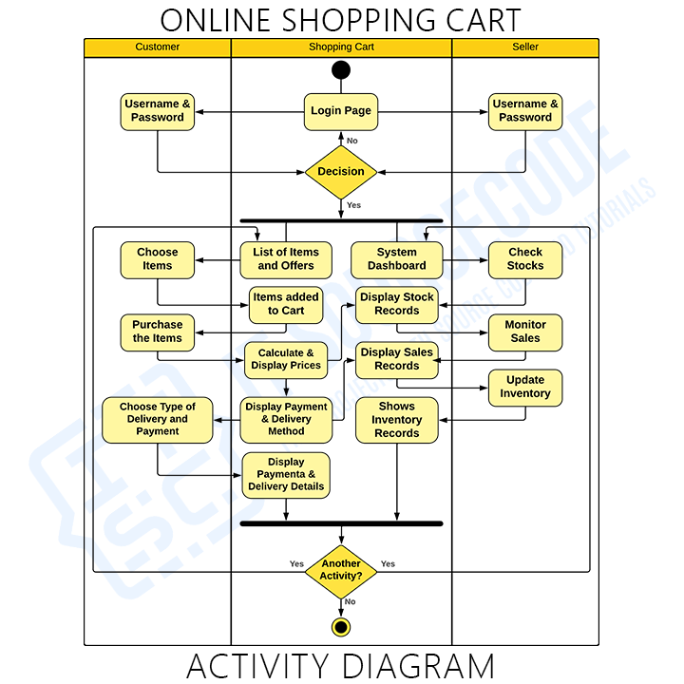

Slide 22
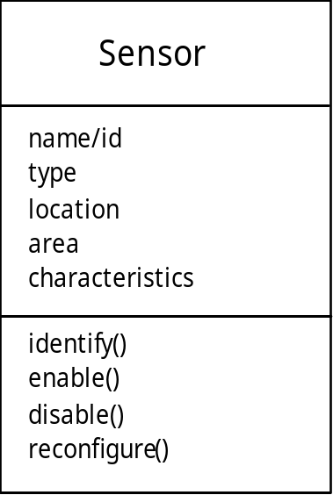
Class Diagram
From the SafeHome system …

Slide 23
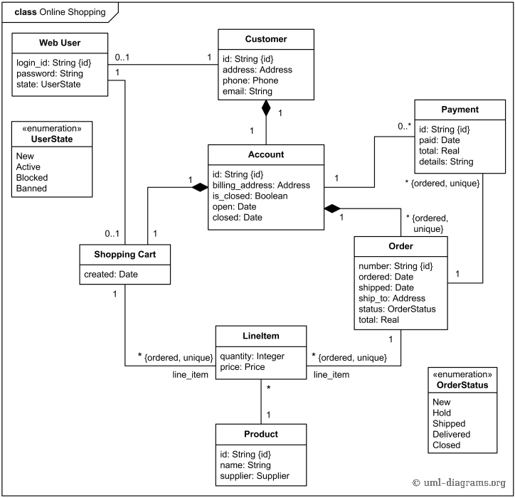

Slide 24
UML State Diagram
Reading
Commands
State name
System status = “ready”
Display msg = “enter cmd”
Display status = steady
State variables
Entry/subsystems ready
Do: poll user input panel
Do: read user input
Do: interpret user input
State activities
software embedded within control panel that is responsible for reading user input.

Slide 25
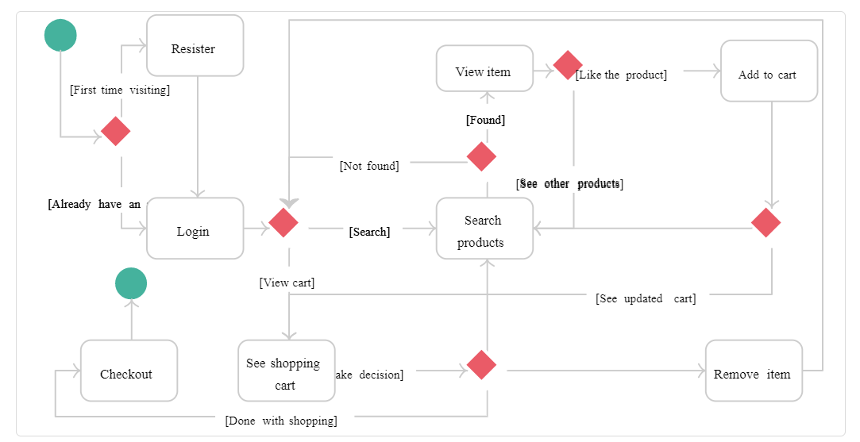
State Diagram – Online Shopping

Slide 26
Analysis Patterns: to Reuse Solutions
  Pattern name: A descriptor that captures the essence of the pattern.
  Intent: Describes what the pattern accomplishes or represents
  Motivation: A scenario that illustrates how the pattern can be used to address the problem.
  Forces and context: A description of external issues (forces) that can affect how the pattern is used and also the external issues that will be resolved when the pattern is applied.
  Solution: A description of how the pattern is applied to solve the problem with an emphasis on structural and behavioral issues.
  Consequences: Addresses what happens when the pattern is applied and what trade-offs exist during its application.
  Design: Discusses how the analysis pattern can be achieved through the use of known design patterns.
  Known uses: Examples of uses within actual systems.
  Related patterns: On e or more analysis patterns that are related to the named pattern because (1) it is commonly used with the named pattern; (2) it is structurally similar to the named pattern; (3) it is a variation of the named pattern.

Slide 27
Negotiating Requirements
Even after inception, elicitation and elaborations, customer requirements are still not sufficient in details to proceed to next activity.
Stakeholders need to balance functionality, performance and other product or system characteristics against cost and time-to-market.
Negotiation is to develop a project plan that meets stakeholder needs while at the same time reflecting the real-world constraints such as time, people and budget.
Identify the key stakeholders
  These are the people who will be involved in the negotiation
Determine each of the stakeholders “win conditions”
  Win conditions are not always obvious
Negotiate
  Work toward a set of requirements that lead to “win-win” for all concerned including the software team.

Slide 28
Art of Negotiation
Recognize that is not a competition.
Map out a strategy.
Listen actively.
Focus on the other party’s interest.
Do not let it get personnel.
Be creative.
Be ready to commit.

Slide 29
Validating Requirements
Is each requirement consistent with the overall objective for the system/product?
Have all requirements been specified at the proper level of abstraction?
Is the requirement really necessary or does it represent an add-on feature that may not be essential to the objective of the system?
Is each requirement bounded and unambiguous?
Does each requirement have attribution?
Do any requirements conflict with other requirements?

Slide 30
Validating Requirements
Is each requirement achievable in the technical environment that will house the system or product?
Is each requirement testable, once implemented?
Does the requirements model properly reflect the information, function and behavior of the system to be built.
Has the requirements model been “partitioned” in a way that exposes progressively more detailed information about the system.
Have requirements patterns been used to simplify the requirements model.
Have all patterns been properly validated? Are all patterns consistent with customer requirements?

